Slide 1
Module-08: Part-1: Recursion Overview
CS 1714 – Computer Programming II

Slide 2
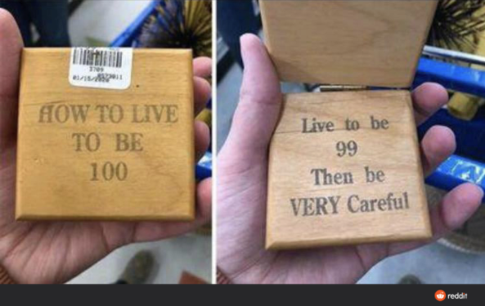
Recursion
Recursion is an approach to solving a problem by breaking that problem into smaller problems and combining those solutions.
The approach to solving the larger problem is the same approach to solving the smaller problems and putting the solutions together.

Slide 3
Recursion
A factorial of a number N is the product of all whole numbers between N and 1.
We use the expression N! to denote a factorial.
4! = 4 * 3 * 2 * 1
3! = 3 * 2 * 1

Slide 4
Recursion
A factorial of a number N is the product of all whole numbers between N and 1.
We use the expression N! to denote a factorial.
4! = 4 * 3 * 2 * 1
3! = 3 * 2 * 1
The task is to compute the factorial of N
Notice that part of 4! can be solved by 3!

Slide 5
Factorial Example – Math Notation
5! = 5 * 4 * 3 * 2 * 1
4! = 4 * 3 * 2 * 1
3! = 3 * 2 * 1
2! = 2 * 1
1! = 1 ← no more recursion is needed
Generalized to N! = N * ( N - 1 )!
is the same as 5! = 5 * 4!
is the same as 4! = 4 * 3!
is the same as 3! = 3 * 2!
is the same as 2! = 2 * 1!
Recall that recursion is solving the larger problem by solving the smaller problems using the same approach and putting the solutions together

Slide 6
Factorial Example in Function Form
Let’s assume you wrote a function factorial() that returns the factorial of a number passed in: int factorial( int n )
factorial( 5 ) → 5 * factorial( 4 );
factorial( 4 ) → 4 * factorial( 3 );
factorial( 3 ) → 3 * factorial( 2 );
factorial( 2 ) → 2 * factorial( 1 );
factorial( 1 ) → 1; ← no more recursion is needed
Generalized to factorial( n ) → n * factorial( n - 1 );
The function call is dependent on a call to itself!

Slide 7
A Recursive Function
Recursion is when a function calls itself directly or indirectly
We will mostly be working with functions that directly call itself.
int recursiveFunction(int n)
{
if(n == 1)
{
return 1;
}
return n * recursiveFunction(n – 1);
}
Here's the recursive call!
The function calls itself, but it passes in a different value into the parameters.

Slide 8
A Recursive Function
Recursion is when a function calls itself directly or indirectly
When calling recursiveFunction(3), recursiveFunction(2) is called. recursiveFunction(2) is not done until recursiveFunction(1) is done.
int recursiveFunction(int n)
{
if(n == 1)
{
return 1;
}
return n * recursiveFunction(n – 1);
}
The original function call is not complete until the recursive call is complete

Slide 9
Parts of a Recursive Function
Look for the recursive call and the base case
int recursiveFunction(int n)
{
if(n == 1)
{
return 1;
}
return n * recursiveFunction(n – 1);
}
Base case. When the function no longer calls itself (no further computations are needed). This decision is usually based on the value of a parameter.
Recursive call. When the function calls itself. Usually, the recursive function involves passing in an updated value of a parameter. You want to make sure that however you change that parameter, you can eventually get to the base case.

Slide 10
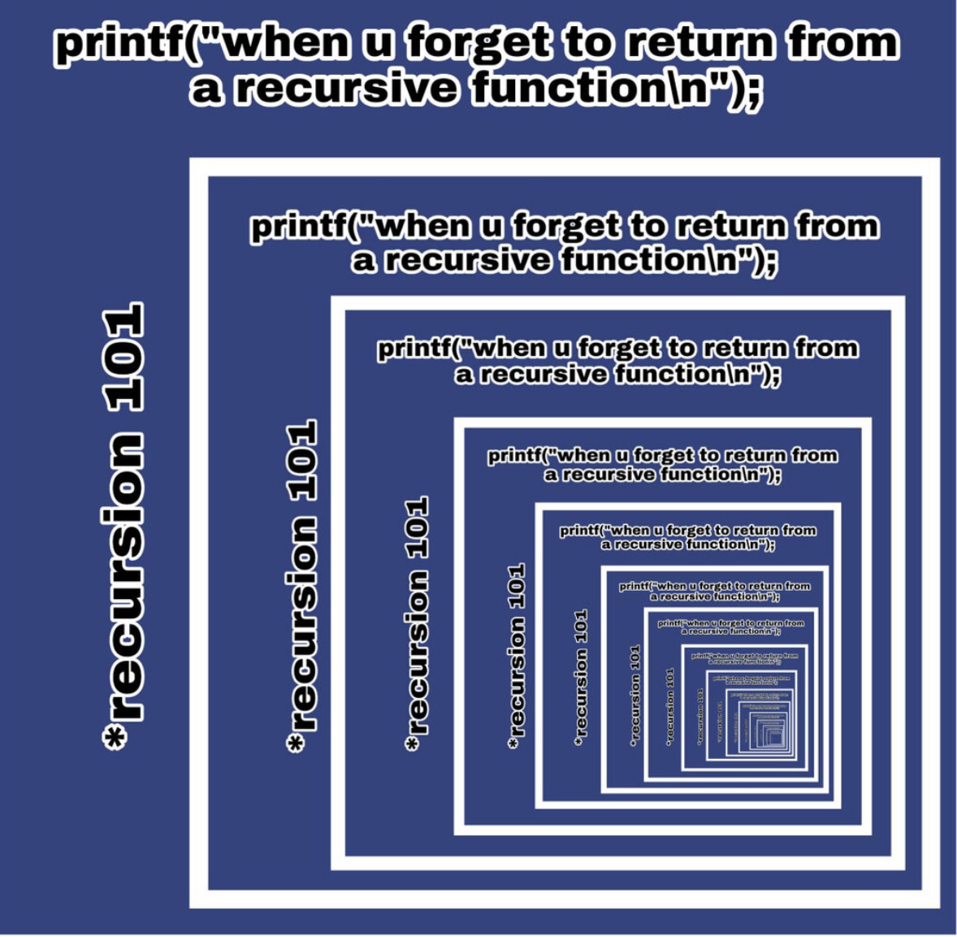
No Base Case?
Each recursive function call is not complete until it has reached a base case OR its recursive call is complete.
If you have no base case, the recursive function calls will keep calling over and over and over and over...

Slide 11
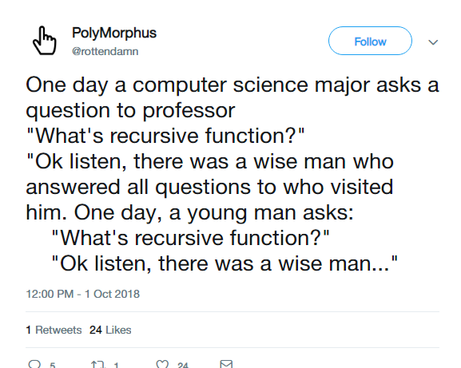
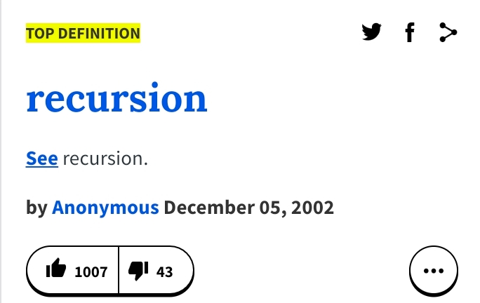
Recursion
A recursive function is when a function calls itself.
The two major parts of a recursive function is the recursive call and its base case. The recursive call should eventually lead us to the base case.

